Slide 1

Home Service Robot
T4- Covers your need, Indeed
Team 4
Ulugbek: 121949815
Abduvokhid: 12194898
Stepheney: 12194937
Azizakhon: 1218745
Javlon: 12204340
Pradip: 12194940
Bijay: 12194945

Slide 2


Contents
About the project
BMC
Research Method
Process- Product Development
Project Implementation Issues
Management(Production, service and price)
Distribution and Logistics
Promotion

Slide 3
Business Model Canvas
Key partners:
Households
Robot Developers
Raspberry Pi developers
3D Printing professionals
Household devices stores
Online marketplaces
Resources we are acquiring:
Data from household interviews
Technical parts of our robot
Key activities:
Advertising. Increasing brand awareness. Patent the product
Distribute to stores. Online sales. Training the device for next update.
Distribution channel: Distribution centers. Orders are delivered and installed.
Profit: from physical and online stores. Economies of scale and selling updates.
Value propositions
Value: we create comfort and convenience for the customers at their homes.
Problems we are solving:
Saving time of busy people
Products and services:
We provide all services from the start of installment to the customization and technical support in case of any technical issues.
Customer relationships
Customer expectations:
Non-luxury household products for middle-class. Reduce household labor.
Relationship tools:
Word of mouth marketing (customer acquisition from other users sharing their positive feedback)
Social media presence (Instagram, Facebook and TikTok)
Customer segments
Major customer segments:
Working women
Single men
Elderly or disabled people
Channels
Sales channels:
Direct sales on our website
Distribution to house appliance stores: Hi-mart, Homeplus, LG Shop, etc.
Online sales: Coupang, Gmarket.
Key resources: Lidar, turtle bot 3, 3D modeled frame, production facilities, employees
Cost structure:
Cost Driven: Our revenue model is based on profit from cheaper production and selling updates. So our main costs are buying product from producing company, advertisement and hardware and software development.
Revenue streams
Revenue sources: Direct sales from our website or Coupang (with delivery and free exchange or return). Buying from stores (exchange available). We generate revenue from the number of products sold. The product updates will be sold each time of release

Slide 4


Marketing research
Purpose of the research
Finding out possible issues than might hinder the sales of the product we are offering and attitude of the customers towards Home service robots
Research goals
A Identifying possible constraints causing customer resistance to such technologies.
B Finding out pain points of existing customers.
C Generating insights about customer expectations from this technologies

Slide 5

Research method
Primary data- convenience survey
Secondary data- existing previous researches on the topic or other similar areas
Target audience for research
Description: People who have used or have a basic understanding of home service robots. Pre-screening required
Age: 20-60 years old
Location: Incheon, South Korea
Career: Stay-at-home parents, students, 9-5 employees
Expected participants: 50 people

Slide 6

Research insights
Pain points:
Safety- unexpected failure of devices, malfunction and causing damage to its surroundings.
Small database- most of the survey respondents mention robots understanding the tasks but not being able to recognise some items to fulfill their given orders.
Battery capacities- survey participants showed needs for longer battery capacities

Slide 7

Benefits of our product
Time-Saving- Home service robots can save time by taking care or routine tasks like picking up and dropping off items.
Convenience- These robots offer a high level of convenience by automating tasks that might otherwise require physical effort or time.
Accessibility- It can be particularly beneficial for individuals with physical limitations or disabilities.
Efficiency- Robots can be programmed to optimize the routes and methods they use to pick up and drop off items, leading to increased efficiency.

Slide 8
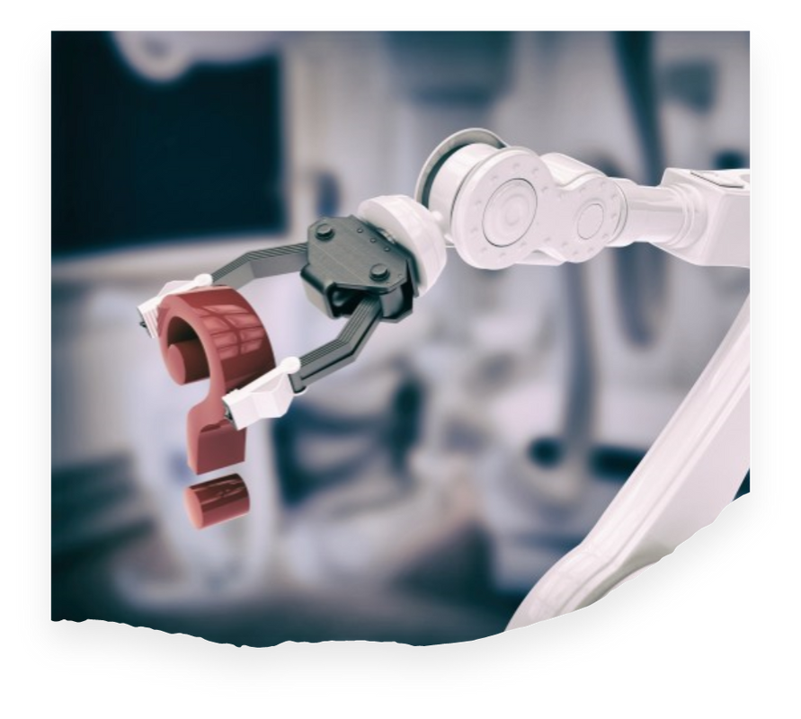
Main Functionality
We have built a home service robot using turtle bot burger 3 for picking up and dropping off items.
Gripper Arm has been added so that it can hold the object while performing the given task. And additionally, Lidar sensor is used for mapping and surveying surrounding, and a camera sensor for visual perception such as navigation and object tracking.
Our main goal is to make people's life better so it will be designed in such a way that specially handicapped and aged people can do their day-to-day chores with more ease and comfort.

Slide 9
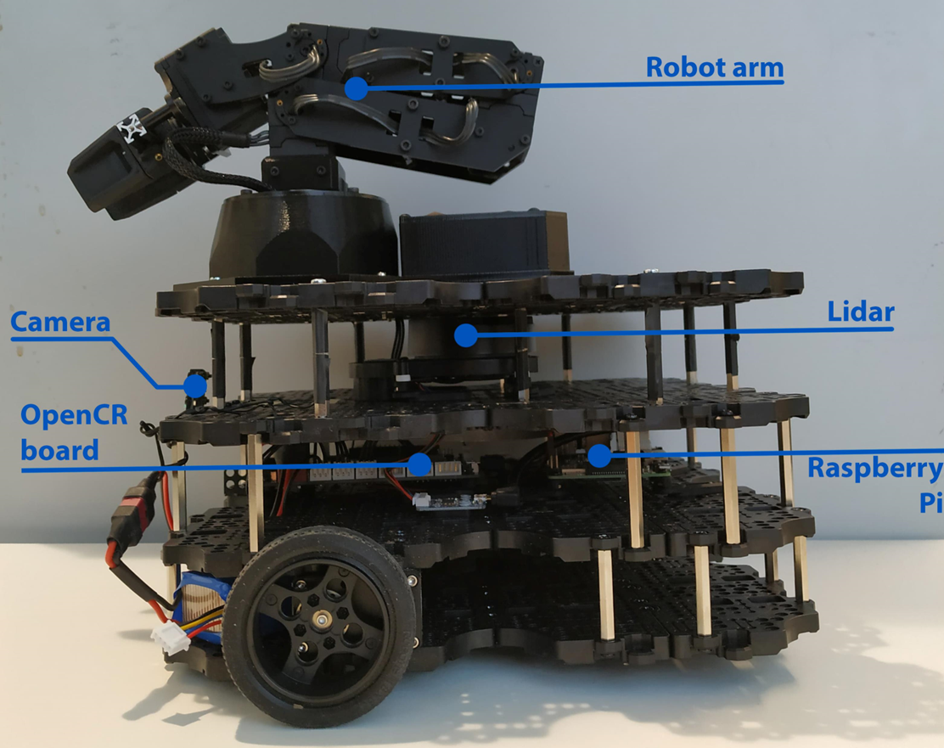
Prototype Design

Slide 10
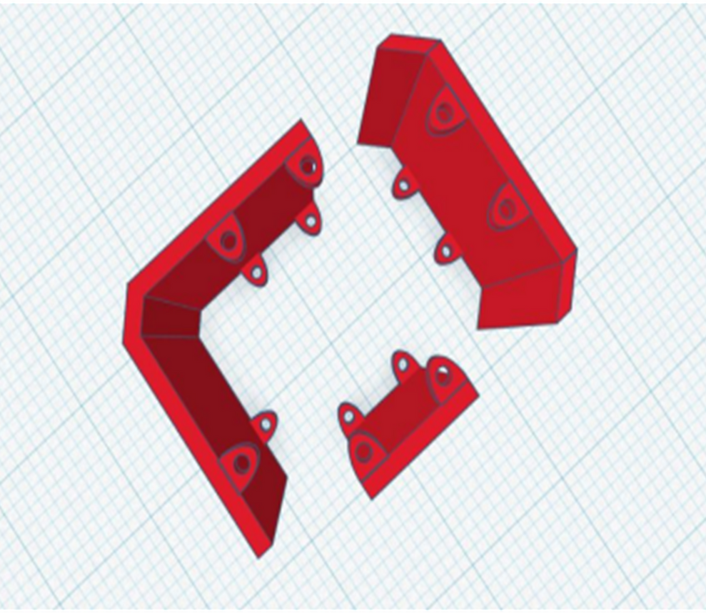
3D Model
A
B
To protect the main body and hardware parts of the product
C
It covers all sides of the kit to avoid falling down while operating
The cover is attached to the main body using selg-tapping screw

Slide 11
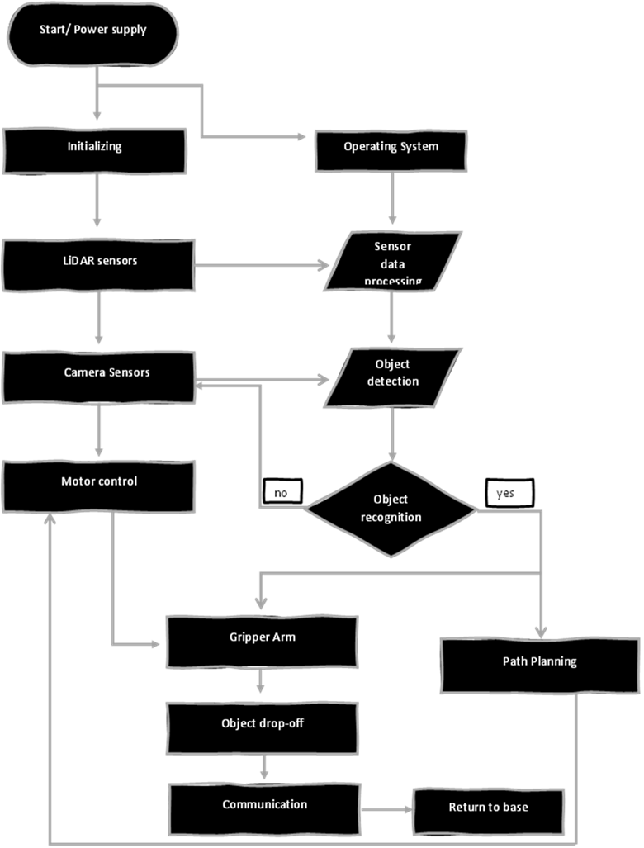
Hardware and Software Flowchart

Slide 12
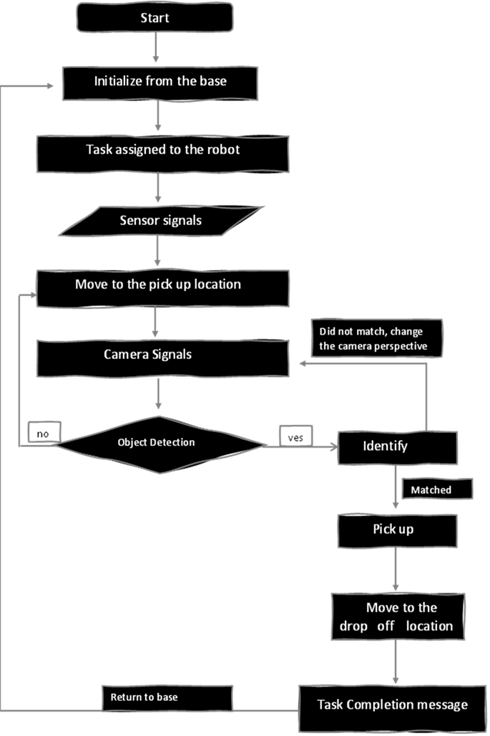
Work Flowchart

Slide 13
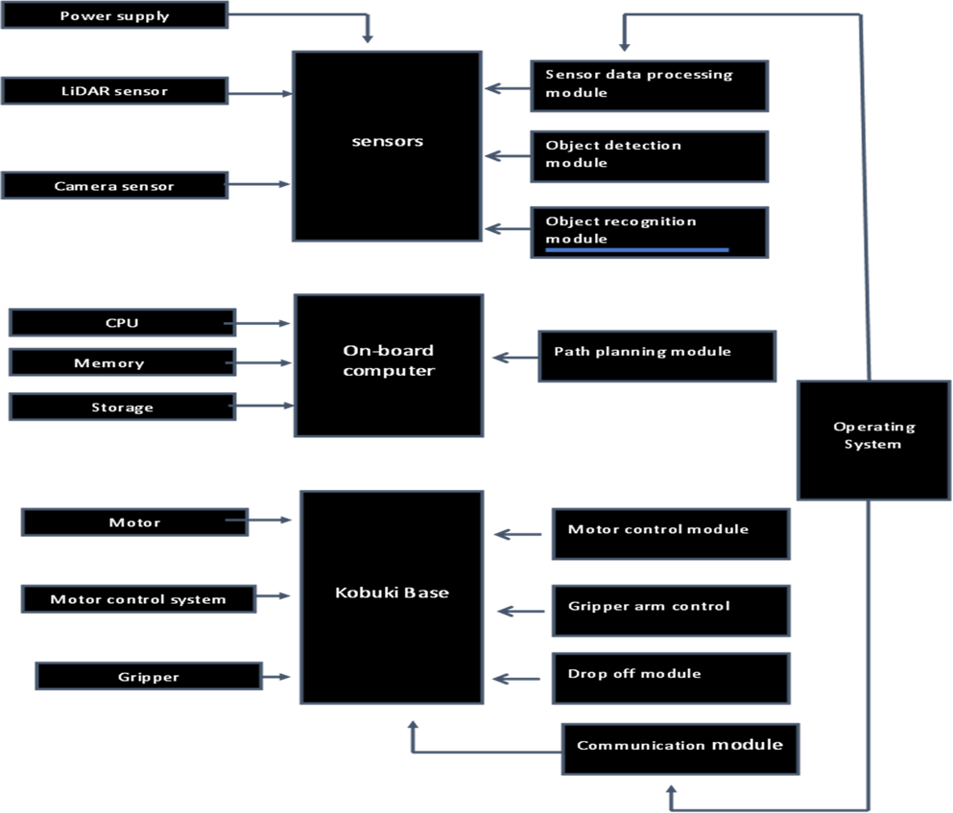
Hardware and Software Architecture
Hardware
Software

Slide 14

Project Implementation Quality (Issues& Solutions)
Issue1: Integrating Lidar and Camera sensors
Issue4: Object Detection and Recognition
Solution1: Ensuring proper integration and sync of the lidar and camera sensor with turtle Bot 3 Burger platform. By connecting the sensors to the appropriate interfaces or ports on the robot and configuring them to work properly
Solution4: Implementing computer vision algorithms to detect and recognize objects using the camera sensor. This involves training or using pre-trained models for object detection, classification, and localization. The algorithms should be optimized for real-time performance on the TurtleBot 3 Burger’s computational resources.
Issue2: Gripper arm Control and Manipulation
Solution2: Implementing control algorithms for the robot’s gripper for precise and reliable picking and dropping of items.
Issue5: Path Planning and Navigation
Solution5: Develop path planning and navigation algorithms that utilize the sensor’s data to avoid obstacles and plan optimal paths for picking and dropping items.
Issue3: Sensor Data Processing
Solution3: Developing robust algorithms for processing the data from the lidar and camera sensors. By implementing sensor fusing techniques to combine the information from the sensors for accurate perception and mapping.

Slide 15

Management – Production and Service
Turtle Bot-3
Arm Cortex
(Source)
Home-Service Robot
(Finished good)
Prototype
Deliver to Customers:
Individuals
Business Organizations
Government Organizations

Slide 16
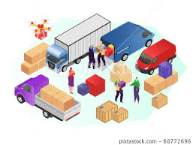
Management – Production and Service
Service Package:
Supporting facility
Facilitating goods
Information
Explicit Services
Implicit services

Slide 17

Pricing Strategy for our product
Market Penetration Pricing Strategy:
Low price with excellent service
Creating brand loyalty
High inventory turnover
Easy to implement for beginners

Slide 18
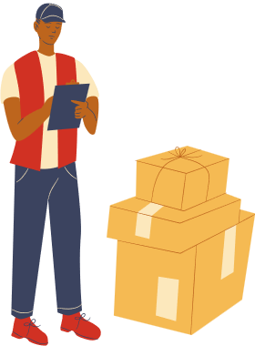
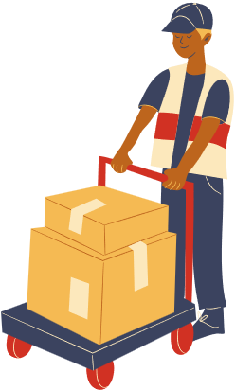
Distribution and Logistics
A
Direct Channel: (Zero- Level)
Online sale: company website
B
Indirect Channel: (One- Level)
Online Marketplace: Coupang, Gmarket
Brick-and-mortar stores: Homeplus, LG Shop
C
Logistics Intermediary
CJ Logistics

Slide 19

Direct Channels
Direct distribution channel allows customers to buy and recieve goods directly from us
Buy through website
Company keeps all aspects of delivery in-house
Solely responsible for ensuring that customers receive their purchase successfully
* Requires more work and can be more expensive to set up. In fact they may require significant capital investment. Warehouses, logistic systems, trucks, and delivery staffs must be put into place

Slide 20
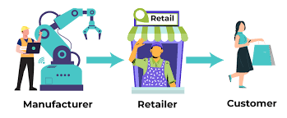
Indirect Channels
Online Marketplace – Ecommerce Marketplace
Coupang put a display ad for targeted customers through Kakao Moment Easisest way to start selling online when we are relatively new to the field. We can create a seller account with these online marketplaces and start selling our products immediately.
Brick and Mortar Stores
Lotte Plaza, Homeplus, Hi Mart, Emart

Slide 21

Marketing 1.1
Sales:
B2C
Customers: Working mothers, Working single men, Students
Channels: Company website, Online Marketplace, Brick-and-mortar stores
B2B
Customers: Restaurants, Cafes, Offices
Channels: Company website, Alibaba.com
B2G
Customers: Public libraries, Hospitals, Post offices
Channels: Company website, Customer office

Slide 22
Marketing 1.2
Promotion:
Brand positioning: “We create comfort and convenience for the customers at their home”
Customers definition: Family women (Anna), People living alone (John), Old or disabled (Stive)
Market segments: B2C, B2B, B2G
Marketing strategy:
- B2C => Discounts for special days (Women’s day), Social media
campaigns (word-of-mouth), free try at stores
- B2B => SEO, web ads, direct-mail marketing
- B2G => SEO, direct-mail marketing, forums/exhibitions

Slide 23

Thank You

